Slide 1
Course Code:CSC402A Course Title: Web Architecture and Application Development
Course Leader:
Kishore S.M.
kishore.cs.et@msruas.ac.in

Slide 2
Objectives
After completing this lecture, the student will be able to
Describe component based software architecture
Describe heterogeneous software architecture

Slide 3
Contents
Component based software architecture
Heterogeneous software architecture

Slide 4
Component-Based Software Architecture
Component-based software architecture divides a problem into sub problems each associated with component partitions
The interfaces of the components play important roles in the component-based design
The main motivation behind component-based design is component reusability: a component encapsulates the functionality and behaviors of a software element into a reusable and self-deployable binary unit
There are many standard component frameworks such as COM/DCOM, JavaBean, EJB, CORBA, .NET, web services, and grid services

Slide 5
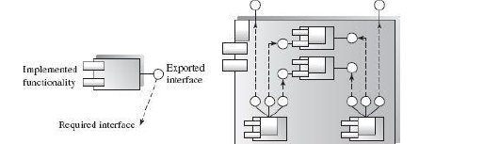
Component-Based Software Architecture
What is a component?
A component is a modular (cohesive), deployable (portable),replaceable (plug-and-play), and reusable set of well-defined functionalities that encapsulates its implementation and exports it as a higher-level interface.

Slide 6
Component-Based Software Architecture
In the generic model in previous figure, a component is represented by a box the inside of which is its implementation
The dark boxes on the boundary represent the exported interface elements, and the “plugs” sticking out represent required explicit context (usually plugged into another component's interface)
The diagram on the right shows how a (larger) component is implemented by interconnecting other components
This larger component can in turn be connected to another component. In this way, a “system” built out of a “network of components” is itself a component

Slide 7
Component-Based Software Architecture
Principles of Component-Based Design
Connections of Components:
The software system is decomposed into reusable, cohesive, and encapsulated component units
Each component has its own interface that specifies the required ports and provided ports; each component hides its detailed implementation
In other words, each component can be seen as a black box building block grouping functionalities and data cohesively as a module (package)

Slide 8
Component-Based Software Architecture
Component-Level Design Guidelines
Use case diagrams describe user interactions with the system which indicate all necessary operations (interfaces) of the component
We can map use case diagrams to the provided service interfaces of the first-cut component specification
The business concept diagram depicts the relationships of the business process entities in the domain
We can extract the business process entities that can exist independently without any associated dependency on other entities
We can recognize and discover these independent entities as new components

Slide 9
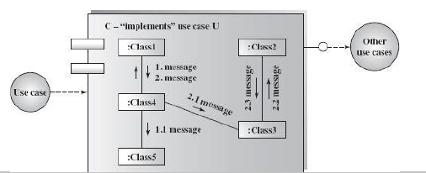
Component-Based Software Architecture
Component-Level Design Guidelines

Slide 10
Component-Based Software Architecture
Applicable domains of component-based architecture:
• Applications where the interface contracts between subsystems are clear
• Applications that require loose coupling between the components and where many reusable components are available
• Suitable for the class library system organization (.NET class library and Java API are built in component architecture)
Benefits:
• Reusability of components
• System maintenance and evolution; easy to change and update the implementation without affecting the rest of the system

Slide 11
Component-Based Software Architecture
• Independency and flexible connectivity of components
• Independent development of components by different groups in parallel
• Productivity for the current and future software development
• Many OO design tools can also be used for component-based software development
Limitations:
• It can be difficult to find suitable available components to reuse
• Adaptation of components is an issue
• Few component-oriented dedicated design tools are available

Slide 12
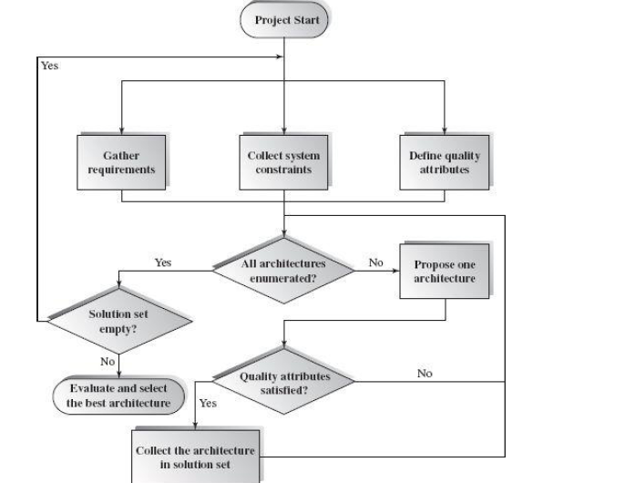
Heterogeneous Software Architecture
Methodology of Architecture Decision

Slide 13
Heterogeneous Software Architecture
Methodology of Architecture Decision
The previous figure presents a simplified architecture selection process combined with requirement analysis
Quality Attributes
Quality attributes are an essential part of the nonfunctional requirements of a system
It is the responsibility of system analysts to put together a complete list of quality attributes before the detailed design process can begin

Slide 14
Heterogeneous Software Architecture
For most computer systems, quality attributes often include efficiency (time efficiency, resource economy), functionality (completeness, security, interoperability), maintainability (expandability, modifiability, testability), portability (hardware independence, software independence, installability, reusability), reliability (error tolerance, availability), and usability (under-standability of code, user interface, learnability)

Slide 15
Heterogeneous Software Architecture
Evaluation of Architecture Designs
How to evaluate an architecture design?
SAAM (Software Architecture Analysis Method)
The general idea of SAAM is to evaluate candidate architecture designs using a collection of scenarios
A design scenario represents an important usage of a system and reflects the viewpoints of stakeholders
The SAAM analysis process generally consists of three stages:
1. Define a collection of design scenarios that cover the functional and nonfunctional requirements. Quality attributes should be reflected

Slide 16
Heterogeneous Software Architecture
2. Perform an evaluation on all candidate architecture designs, using the collection of scenarios
3. Perform an analysis on the interaction relationship among scenarios

Slide 17
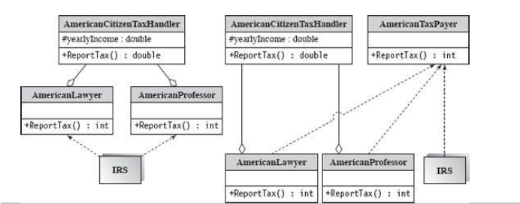
Heterogeneous Software Architecture
The following case study demonstrates the first two stages in SAAM
Assume that you are going to design an online tax processing system for the Internal Revenue Service (IRS)

Slide 18
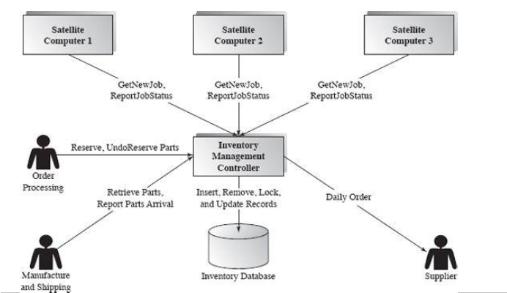
Heterogeneous Software Architecture
Architecture Design of Inventory Management – Case Study

Slide 19
Heterogeneous Software Architecture
Architecture Design of Inventory Management – Case Study
Inventory management should include:
A database which maintains information on all parts stored in the warehouse;
A controller system which is able to accept remote invocation from the Order Processing and Manufacture and Shipping components; and
Satellite computers (with barcode scanners) that are used by the workers.

Slide 20
Summary
Component-based software architecture divides a problem into sub problems each associated with component partitions

